Slide 1
Soft Robotic Arm ROCO504
By
Joshua Sullivan
Alex Rowe
Simon Walker

Slide 2
Introduction and Goals
Develop an arm that
Replicates the movement of a human arm.
Throws a projectile further than if the servos where statically connected to one another.
Uses 3D printer materials, designed on AutoDesk Fusion 360
Is comparable to a human arm.
Notes:
This project looks at soft robotics and how the sudden release of stored energy can help a robot arm throw a ball.
A human arm uses antagonistic muscle pairs to throw a projectile, we aim to replicate this with our robotic arm. This will allow the robotic arm to throw a projectile further than the servos could if in a direct drive system.
This is desirable as typically larger servos would be required that cost more, weigh more and take up a larger amount of space.

Slide 3
Requirements
Throw a projectile further than with direct drive servos.
Utilise energy storage from tendons.
Replicate the design and motion of a human arm.
Movement constrained to that of a human arm.
Cover at least 4 of the following topics:
CAD (e.g. Autodesk Fusion 360)
CAM (e.g. 3D printing)
Finite Element Analysis (FEA)
Tensile/hardness testing
Agonist-antagonist joints
Soft mechanisms and materials
Embodied artificial intelligence

Slide 4
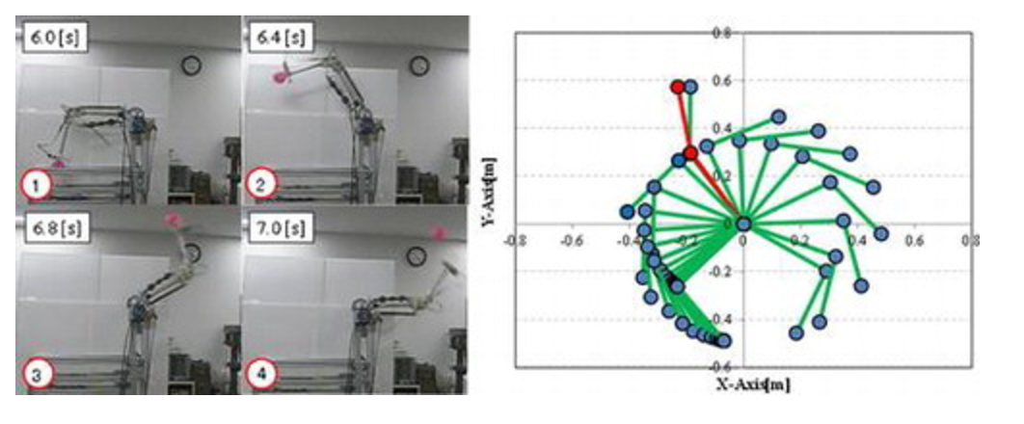
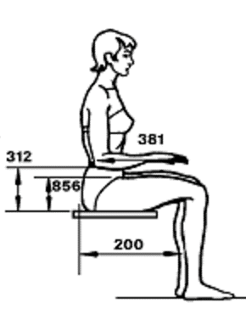
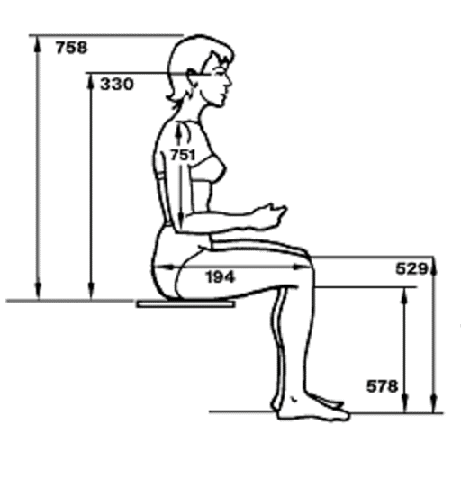
Research
Reference: 276, pp. 32-79; NASA-STD-3000 275e
T. Nagayama, H. Ishihara, H. Tomori & T. Nakamura
Pages 1365-1379 | Received 17 Oct 2015, Accepted 29 Jun 2016, Published online: 09 Aug 2016
Notes:
Verification of throwing operation by a manipulator with variable viscoelastic joints with straight-fiber-type artificial muscles and magnetorheological brakes
Increasing the power will increase the output but also the weight
Humans used stored energy and release it suddenly
This study looks at a Two degree of freedom robot arm with variable viscoelastic joints
straight-fiber-type artificial muscles and a magnetorheological (MR) brakes
In this paper, we try to optimize parameters of the throwing movement by combining the spring model of a two-DOF variable viscoelastic manipulator with the Particle swarm optimisation method.
ANTHROPOMETRY AND BIOMECHANICS paper by nasa
40 year old Asian lady

Slide 5
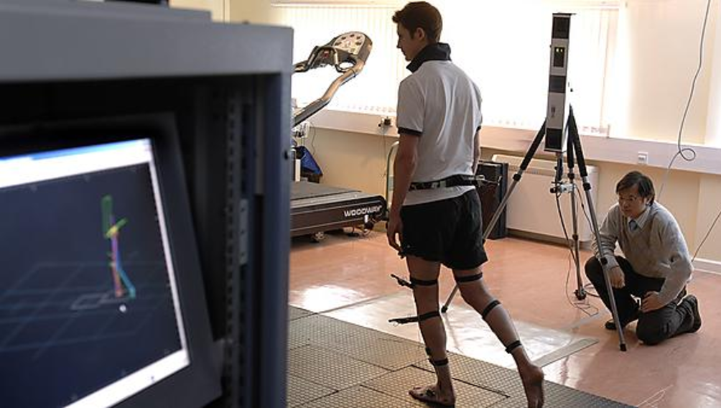
Human Movement and Function Laboratory (HMFL)
The Human Movement and Function Laboratory (HMFL) uses a range of highly advanced equipment, often in combination, in order to provide analysis and perspective on an individual’s movement and function.
What we want to use it for?
Study the movement of a human arm as it throws a ball
Compare the robot arm against a human arm
Notes:
Medical school
Booked meeting
Study human arm
Study robot arm

Slide 6
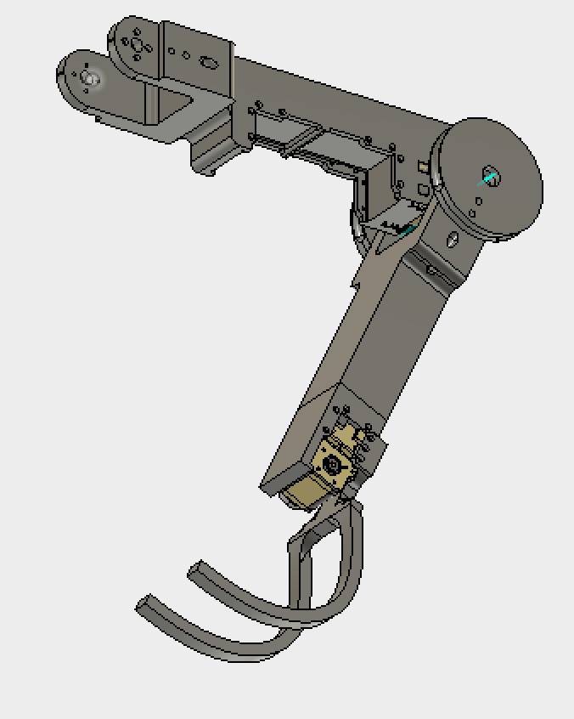
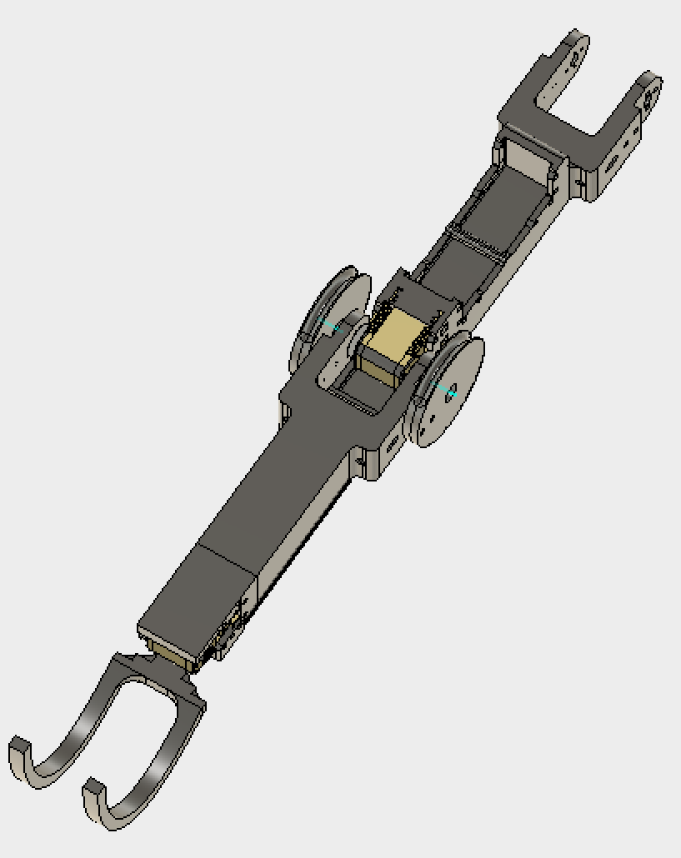
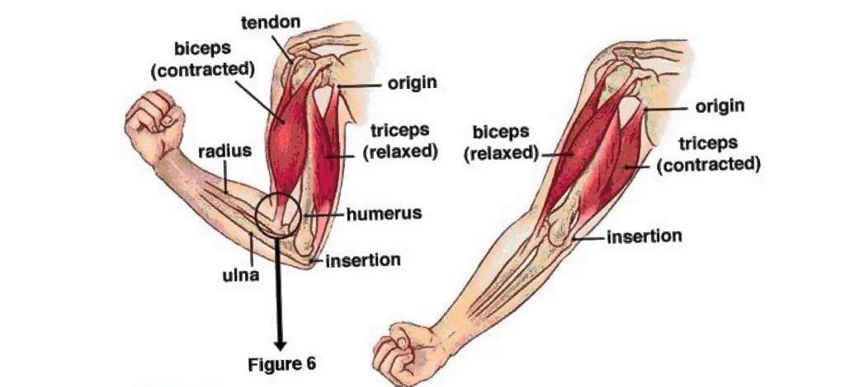
Antagonistic Joint Control
The Arm will use antagonistic muscle pairs that work opposing to each other to control the movement at the shoulder and elbow joint.
Notes:
Antagonisitc muscle pair
One contracts
One relaxes

Slide 7
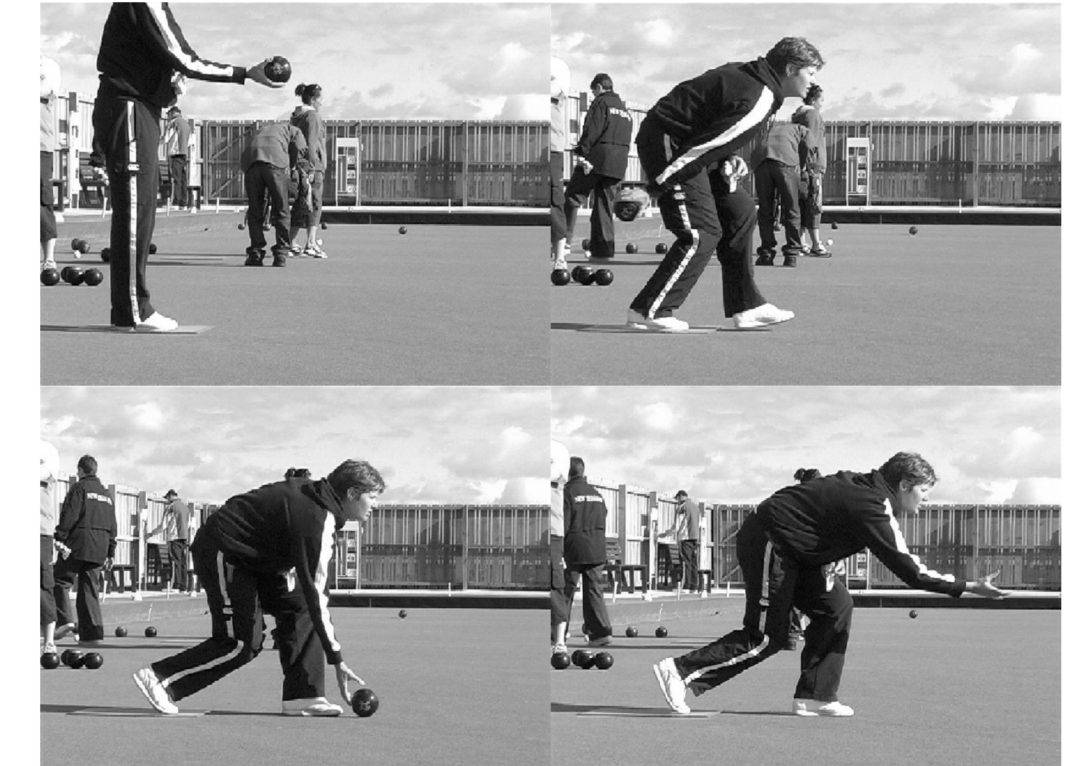
Antagonistic Joint Control
298mm
417mm

Slide 8
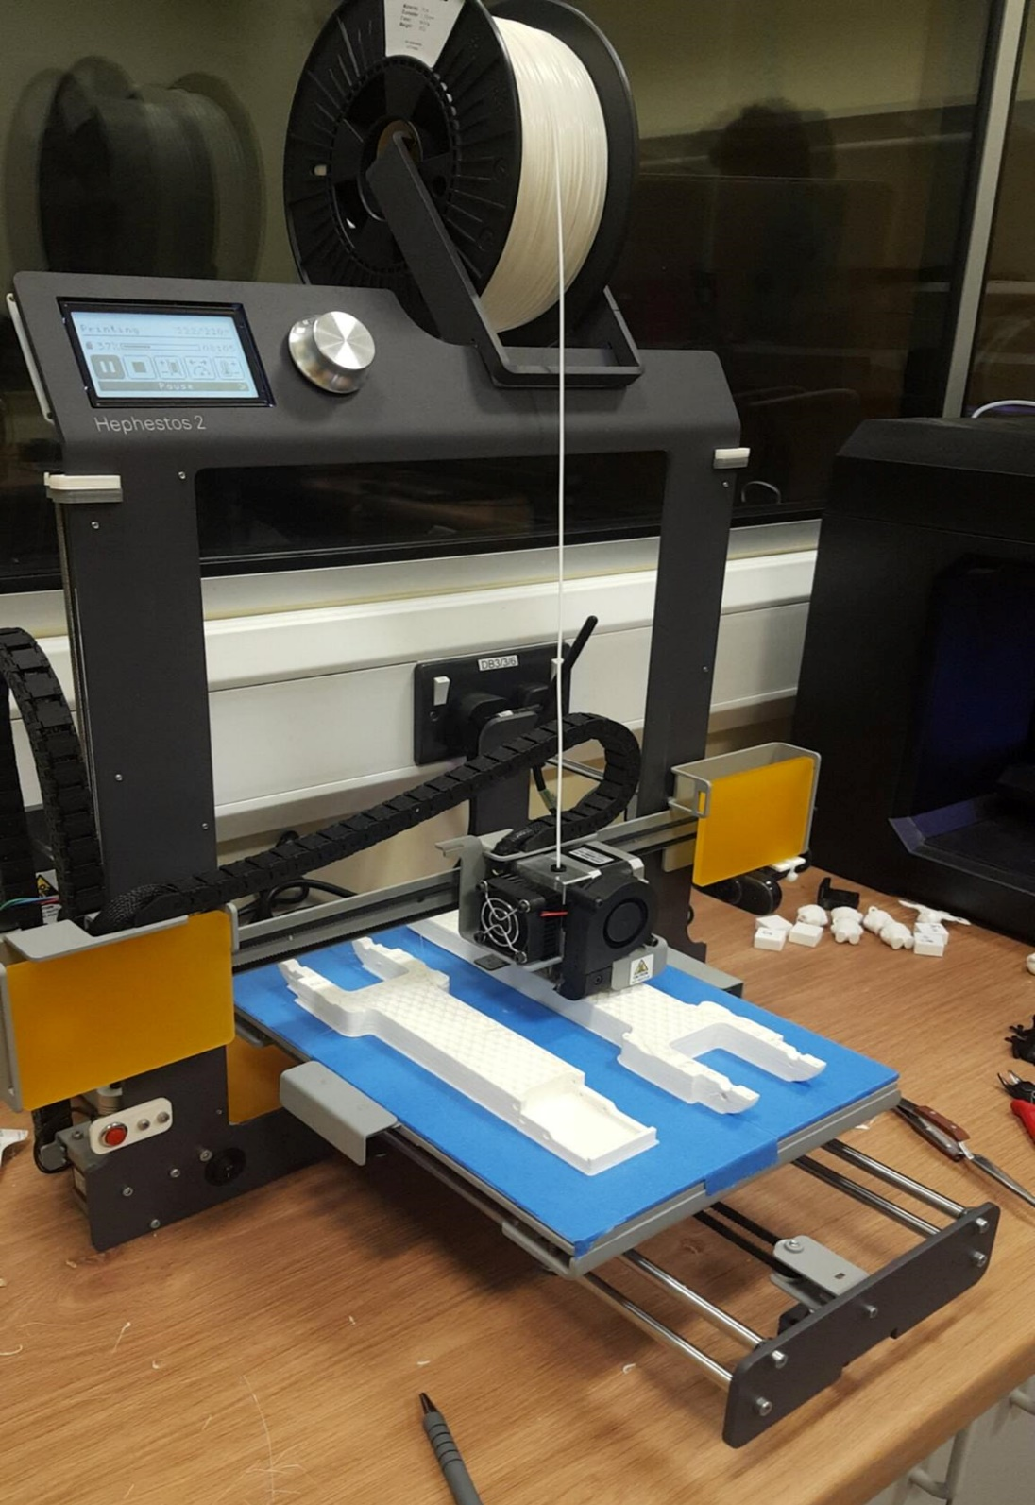
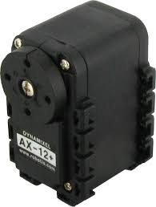

Hardware and software used/required
3D printed parts
3D Printers (Makerbot and Hephestos 2)
Cura
AutoDesk Fusion 360
LabView
3x AX-12 Servos and 2x MX-64T Servos for controlling the movement
2x AX-12 Servos as encoders in the shoulder and elbow joint

Slide 9
